Slide 1
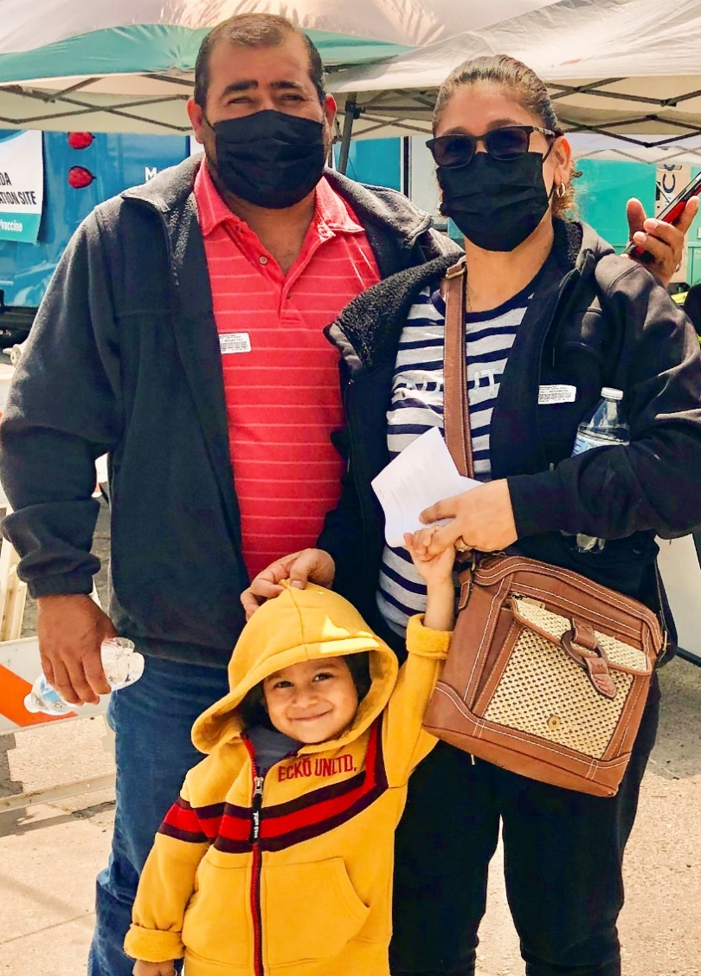





2
Include information on local vaccination efforts
Use the top portion back cover of the brochure to provide resources and links out to more information on vaccination in the area.
The text on this panel is completely editable and new text can be added by
right clicking on the border of a text box → selecting copy from the menu →
right click where you want the new text box → select Paste from the menu
1
VAKSEN KONT COVID-19 YO SAN DANJE EPI YO EFIKAS
Kòman mwen kapab jwenn Vaksen kont COVID-19?
Add an image and scale it
Go to Insert → Image → Upload from Computer and select an image of you that you’d like on the brochure cover.
To scale, grab bottom right corner of image and hold the clicker down. Drag your mouse or finger across diagonally until it’s the same size/slightly bigger than the slide.
Send your image back
Once you size your image and scale it proportionally to the size of the slide or slightly bigger, right click on the image and go to Order → Send to back
Crop your image
If the image is larger than the brochure cover, you can crop it by right clicking on the image and selecting the Crop tool that appears in the pop-up menu. You can then drag the black bars at the edges of the image to trim it to the right size. Click outside of the image to apply the changes.
Tout moun ki gen sis mwa oswa plis ta dwe pran yon vaksen kont COVID-19 ki ajou!
Moun ki te pran vaksen anvan oswa ki poko janm pran vaksen ap pran sèlman yon vaksen.
Gen kèk moun ki pran plis pase yon vaksen: timoun ki gen sis mwa rive 5 an, ki gen sistèm iminitè ki fèb, epi moun ki gen 65 an oswa plis ta dwe pale ak doktè yo.
Vaksen an gratis pou pifò moun, menm pou moun ki pa gen asirans.
Chèche konnen ki kote ou ka jwenn aksè gratis ak vaksen kont KOVID la gratis:
Mande si pa genyen klinik mobil ak ekspozisyon sou sante
Depatman sante
Sant Sante Kominotè
Famasi bò lakay ou
Pale avèk patwon w lan sou fason ou kapab jwenn vaksen kont KOVID-19 la. Yo ka ede w nan aranjman w ap fè pou jwenn yon vaksen.
Jwenn vaksen: https://www.vaccines.gov/search/
Rekòmandasyon
Pran dènye dòz vaksen ou an.
Fè fanmi ou pran dènye dòz vaksen yo.
Yo rekòmande Pfizer oswa Moderna.
Mete yon mas nan espas anndan oswa deyò ki gen anpil moun, menm si ou deja pran dènye dòz vaksen yo.
Si w te ekspoze ak KOVID-19, swiv etap sa yo, menm si w pran vaksen:
  Pote yon mas pandan 10 jou.
  Si ou gen sentòm: Izole. Fè tès imedyatman.
  Si ou pa gen sentòm: Fè tès omwen 5 jou konplè apre kontaminasyon an. Si ou pozitif, izole tèt ou!
  Si tès ou a pozitif oswa si w gen sentòm, gade direktiv CDC yo pou konnen kijan pou izole tèt ou.
Pou w jwenn plis enfòmasyon
Pwoteje Tèt ou Kont COVID-19
Vizite Sant Kontwòl Maladi yo ak Pwevansyon:
https://www.cdc.gov/coronavirus/2019-ncov/
Pou Repons ak Keksyon yo poze souvan, vizite Migrant Clinicians Network:
https://bit.ly/3ki1xAI
Pran yon Vaksen kont KOVID ki ajou
Pou fi yo:
Pou fi ki ansent, ki ap bay tete, oswa ki ap eseye ansent, vaksen yo enpòtan anpil pou kenbe manman ak ti bebe yo an sante.
Mizajou: 5 Oktòb 2023
Kanpay Sansibilizasyon pou Vaksen
kont COVID-19
3
Add information on your organization and other relevant resources
The bottom portion of the back cover allows you to include organizational links, phone numbers, and other information useful to your community.
Be sure to include a date on the brochure as information
changes quickly.

Slide 2
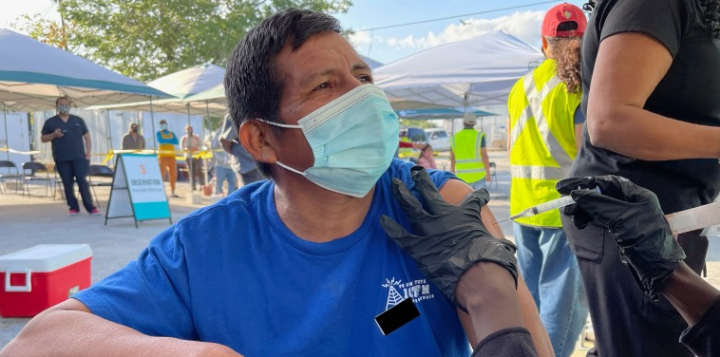

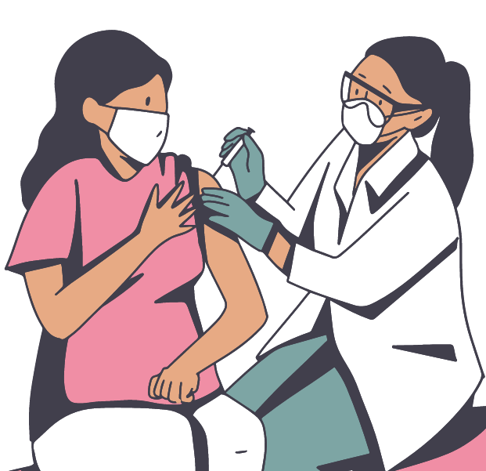

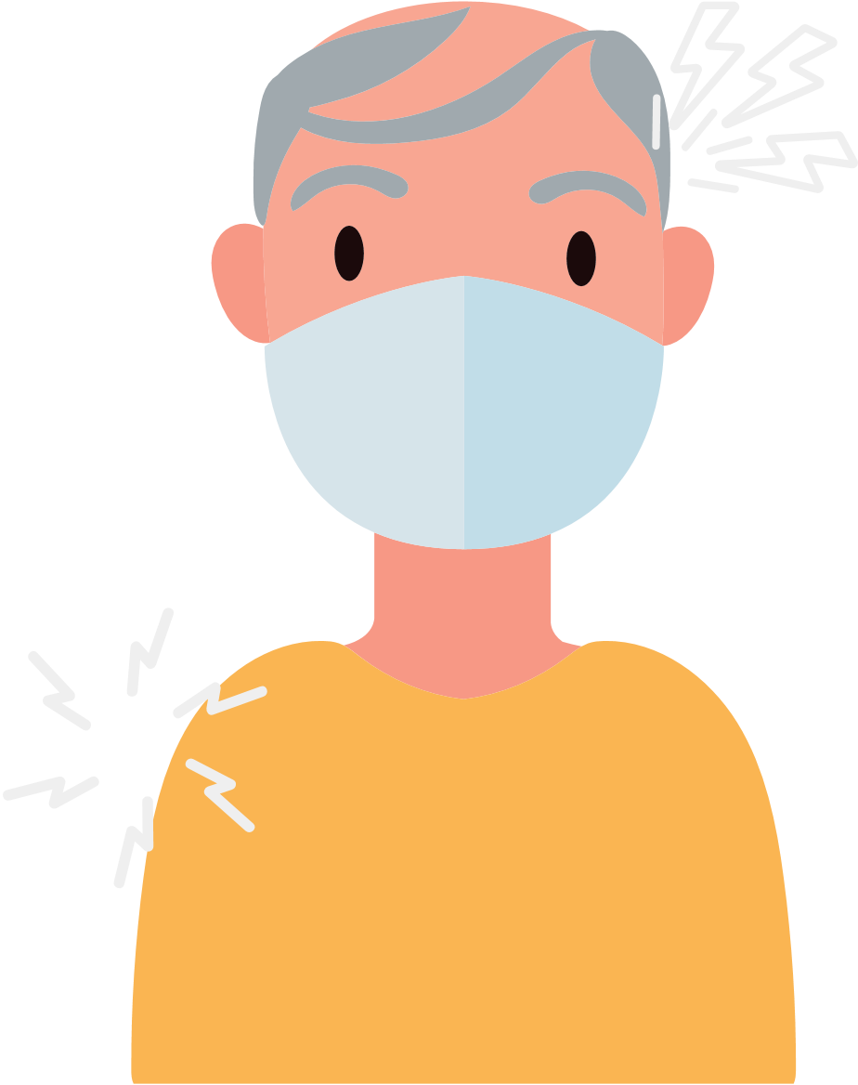



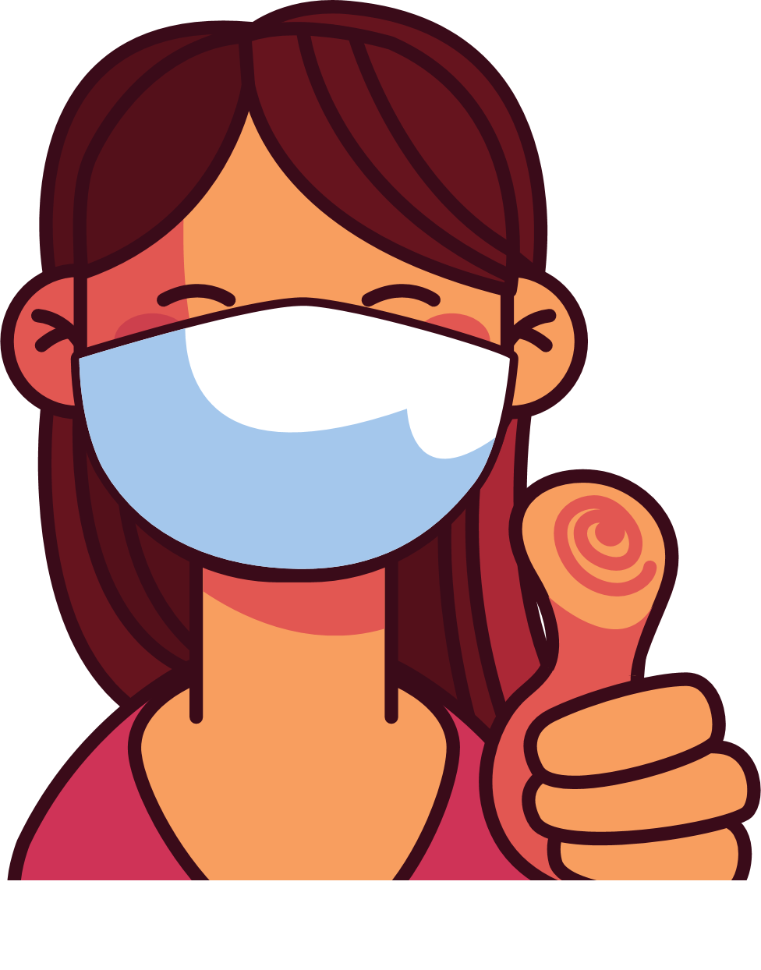
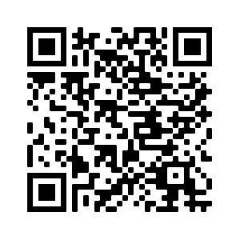
4
Address Concerns in the Community
This panel is intended to provide information addressing the concerns specific to the community receiving
the brochure.
The text boxes with the questions and answers can be edited, copied or deleted so you can customize this panel to fit your needs.
Here you can include links to relevant resources or more information addressing the community’s concerns.
KISA POU KONNEN LÈ W AP PRAN VAKSEN COVID
Kòman m ap fè konnen kilè oswa si mwen bezwen yon lòt vaksen an?
Moun ki gen sistèm iminitè ki fèb yo bezwen dòz vaksen anplis.
Moun ki gen 5 an oswa plis bezwen pran yon vaksen kovid ki ajou omwen 2 mwa apre yo fin pran dènye vaksen yo a si yo te pran dòz vaksen kont KOVID anvan.
Chèche jwenn dènye enfòmasyon sou vaksen yo.
Avantaj Vaksinasyon an
Li enpòtan pou pran vaksen an, menm si ou te gen COVID-19.
Chèche konnen ki kote ki ofri vaksen gratis nan eta w la oswa depatman sante, famasi oswa sant sante nan zòn pa w la.
Vaksinasyon an pwoteje w, fanmi w, ak kòlèg ou yo kont maladi grav epi pou yo pa entène lopital.
Vaksinasyon an diminye kantite nouvo ka COVID-19 ki grav epi ki tiye moun nan kominote ou a.
Vaksinasyon an pwoteje lopital ak doktè yo pou yo pa plen avèk pasyan ki malad grav avèk COVID-19.
Plis gen moun nan kominote nou an ki vaksine, mwens nou bezwen enkyete pou nouvo varyan yo.
Nan pa twò lontan nou ap kapab retounen nan aktivite nòmal nou si gen plis moun
ki vaksine.
Kisa Mwen Ta Dwe Fè Si Mwen Te Resevwa Vaksen Kont Kovid Nan Yon Peyi Diferan Epi Li Pa Disponib Nan Peyi Etazini?
Se pa tout peyi ki apwouve menm vaksen kont COVID-19 avèk Etazini.
Gen kèk vaksen ki pa disponib Ozetazini men yo rekonèt yo. Si Sant Kontwòl ak Prevansyon Maladi (Centers for Disease Control and Prevention, CDC) rekonèt vaksen w lan, epi w gen kat vaksen, lè konsa ou pa bezwen rekòmanse. Ou ka pran yon dòz vaksen mesaje Asid RiboNikleyik (messenger RiboNucleic Acid, mRNA) (Pfizer oswa Moderna) pou w ka fin pran vaksinen an nèt. Si w pa gen kat vaksen, ou pral bezwen rekòmanse. Chache wè yon doktè pou konnen kantite tan ki rekòmande pou pran pran dòz yo.
Tout vaksen kont KOVID-19 yo san danje epi yo efikas.
Apre vaksinasyon an ou ka gen: doulè nan bra, tèt fè mal, lafyèv, oswa frison.
5
Save the file as a PDF
Once the content of the brochure has been finalized, you can save the file as a PDF for printing and distribution.
Export as a PDF using PPT:
Select slide. File → Save As Adobe PDF
Export as a PDF using Google Slides:
File → Download → PDF Document
Risk ki genyen pou moun ki pa
pran vaksen an
Ou ap santi w byen kèk jou apre ou fin pran piki a.
Yo konsidere ou ajou depi w resevwa dòz ou bezwen an (yo).
Ki kote mwen ka jwenn
plis enfòmasyon?
Plis risk pou kontamine ak COVID-19.
Plis risk pou gen gwo enfeksyon, entène lopital ak lanmò.
Si yon majorite moun PA PRAN VAKSEN kont COVID-19 la, alò risk pou gen maladi ki grav epi risk pou gen nouvo mitasyon ki pi kontajye ak danjere vin pi plis.
Vizite Sant pou Kontwòl ak Prevansyon Maladi: https://www.cdc.gov/coronavirus/2019-ncov/
Kontinye mete mask nan espas kote ki chaje moun epi lave men ou.
Ou fè pati pa w la pou pwoteje tèt ou ak lòt moun kont COVID-19 la!

