Slide 1
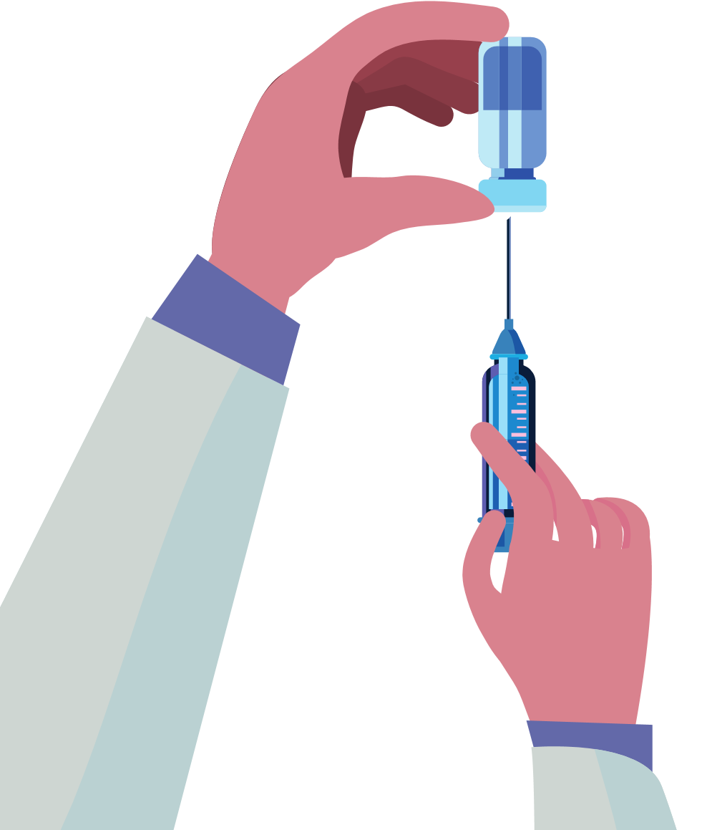
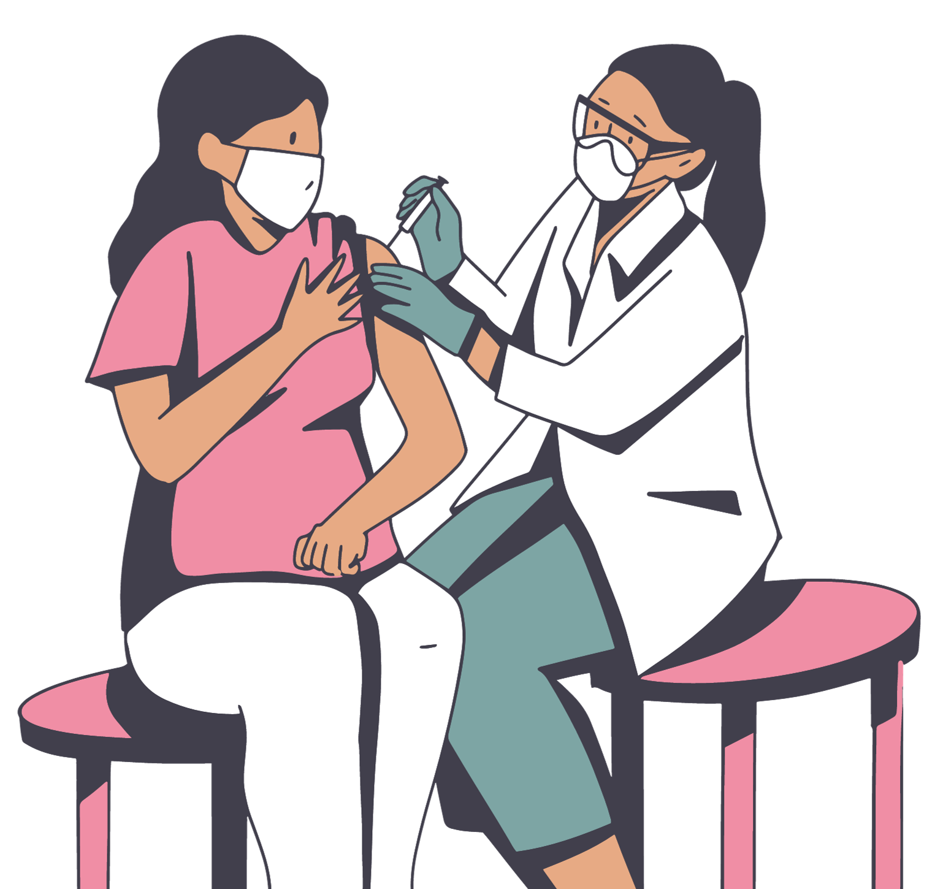
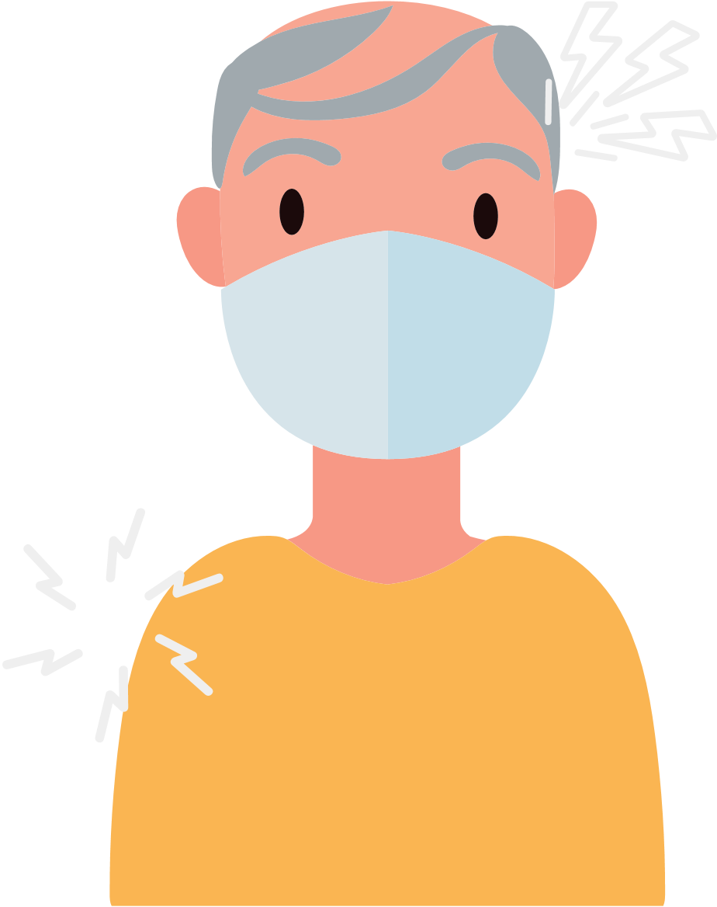
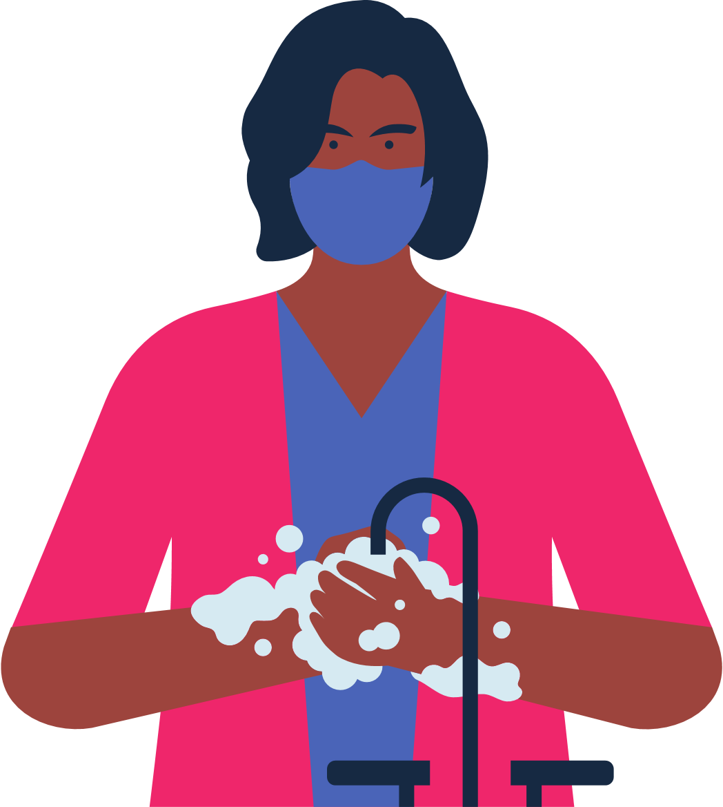
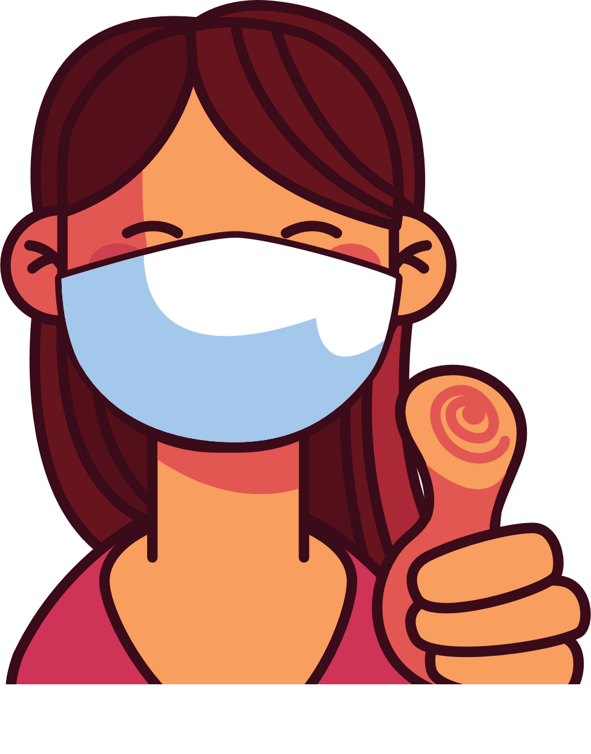
What to Expect When Getting the COVID-19 Vaccine
Even if you’ve had COVID-19, it is important to get the vaccine.
Check if vaccines are offered for free at your state or local health department or pharmacy.
Check with your health care provider to determine what COVID-19 vaccine you need.
You may have a sore arm, headache, fever or chills after receiving the vaccine.
You will start to feel better after a couple of days.
You are considered up to date once you receive your needed dose or doses.
Vaccines.gov
Continue to wear a respirator in crowded spaces and wash your hands.
Congratulations, you did your part in keeping yourself and others safe!
Find a location near you!
Search using the map on www.vaccines.gov/search

