Slide 1
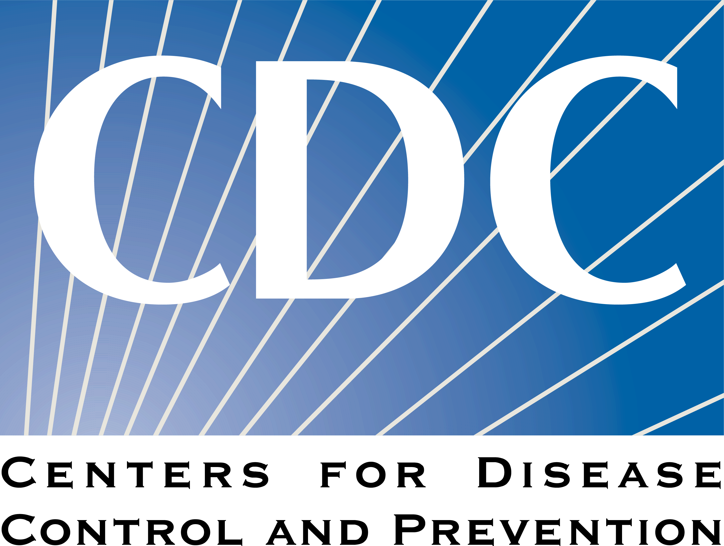
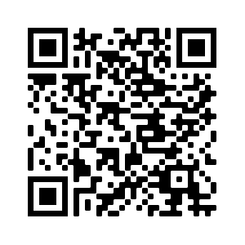
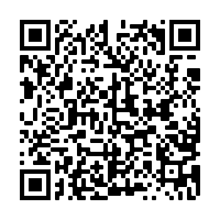
2
Include information on local vaccination efforts
Use the top portion back cover of the brochure to provide resources and links out to more information on vaccination in the area.
The text on this panel is completely editable and new text can be added by right clicking on the border of a text box → selecting copy from the menu → right click where you want the new text box → select Paste from the menu
1
Is the vaccine safe for me and my baby? What has changed over time?
HOW DO I GET A COVID-19 VACCINE?
Add an image and scale it
Go to Insert → Image → Upload from Computer and select an image you would like to use on the brochure cover.
To scale, grab bottom right corner of image and hold the clicker down. Drag your mouse or finger across diagonally until it’s the same size/slightly bigger than the slide.
Send your image back
Once you size your image and scale it proportionally to the size of the slide or slightly bigger, right click on the image and go to Order → Send to back
Crop your image
If the image is larger than the brochure cover, you can crop it by right clicking on the image and selecting the Crop tool that appears in the pop-up menu. You can then drag the black bars at the edges of the image to trim it to the right size. Click outside of the image to apply the changes.
Early in the pandemic, we didn't know the effects of the vaccine on pregnant and breastfeeding women and their babies.
Now, we have lots of data, and we can confidently say: the COVID-19 vaccine is very safe for you and your baby, before, during, and after your pregnancy!
As of September 2023, hundreds of thousands of pregnant women have been safely vaccinated against COVID-19.
There have been no reports of any increased risk of pregnancy loss, growth problems, or birth defects.
The COVID-19 vaccine is not a live vaccine, and pregnant and breastfeeding women and their babies cannot get COVID-19 from the vaccine.
There is no need to 'pump and dump' when getting a vaccine while breastfeeding.
The vaccine is free for most people, including
those without insurance.
Check to see where to access COVID vaccines for free:
Talk to your OB/GYN
Ask about mobile clinics and health fairs
Health department
Community health center
Pharmacies near you
Speak with your employer about getting the COVID-19 vaccine. They may be helpful in making arrangements to get a vaccine.
Find vaccines: https://www.vaccines.gov/search/
In fact, the real risk is when a pregnant woman chooses NOT to get vaccinated.
FOR MORE INFORMATION
Women who become ill with COVID-19 and have symptoms during pregnancy:
Are more likely to get very sick from COVID-19 compared to those who are not pregnant.
Are more likely to need ICU care.
Are more likely to need a breathing tube.
Are at an increased risk of dying.
Are at an increased risk of having a stillbirth or preterm birth.
May be at an increased risk of having a baby infected with COVID-19.
Visit Centers for Disease Control and Prevention:
https://www.cdc.gov/coronavirus/2019-ncov/
Pregnancy, Breastfeeding, and the COVID-19 Vaccine
For answers to Frequently Asked Questions, visit Migrant Clinicians Network (MCN): https://bit.ly/3ki1xAI
Get An Updated COVID Vaccine
Updated: August 5, 2024
COVID-19 Vaccine Awareness Campaign
3
Add information on your organization and other relevant resources
The bottom portion of the back cover allows you to include organizational links, phone numbers, and other information useful to your community.
Be sure to include a date on the brochure as information changes quickly.

Slide 2
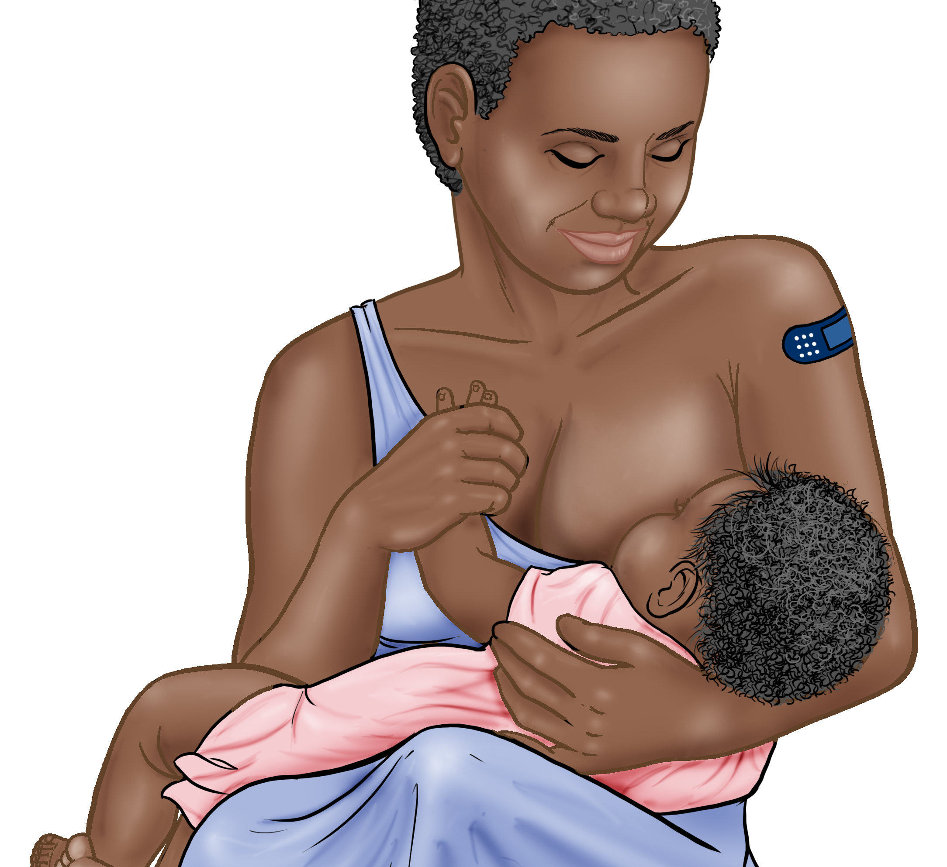
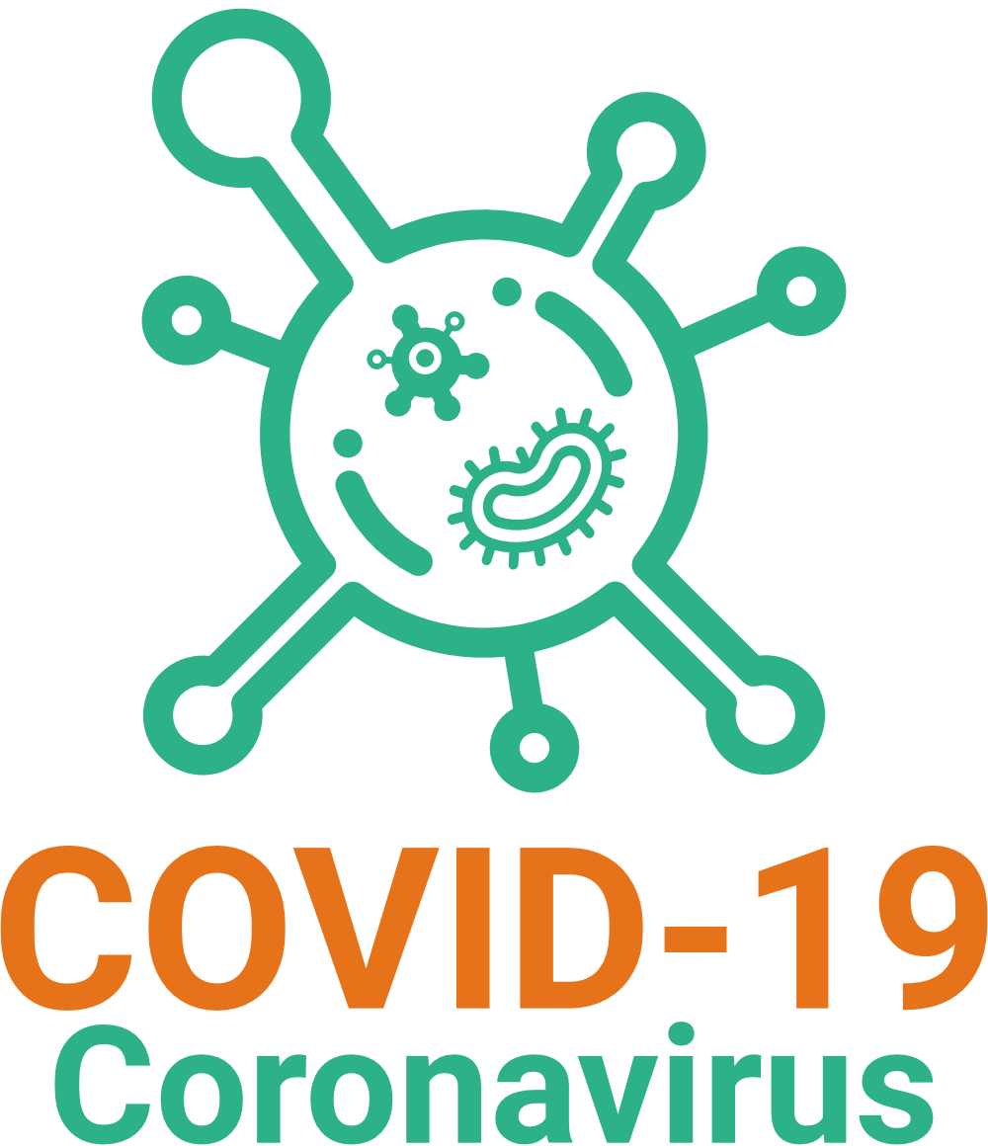
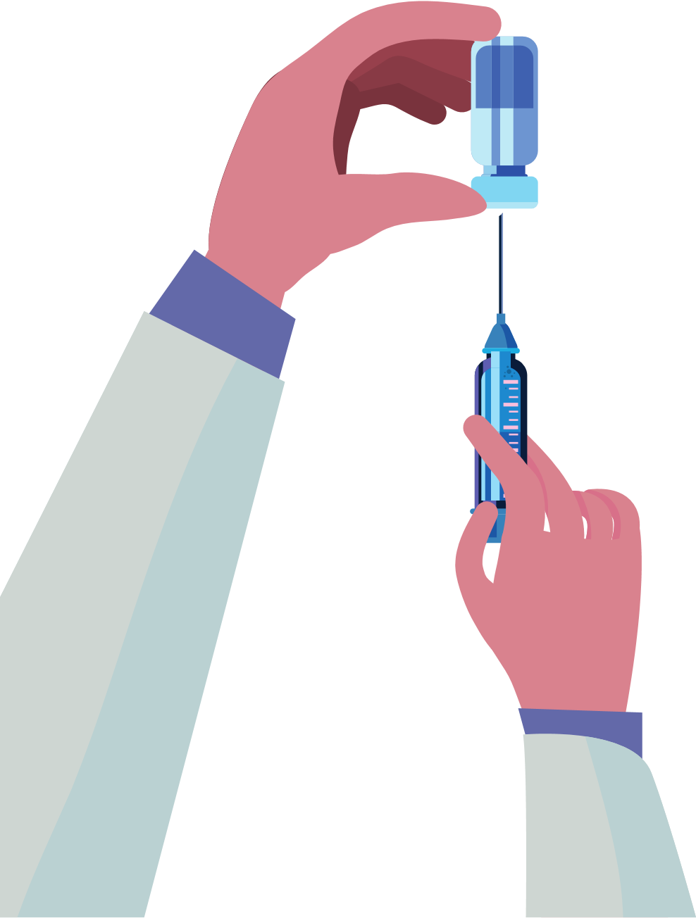
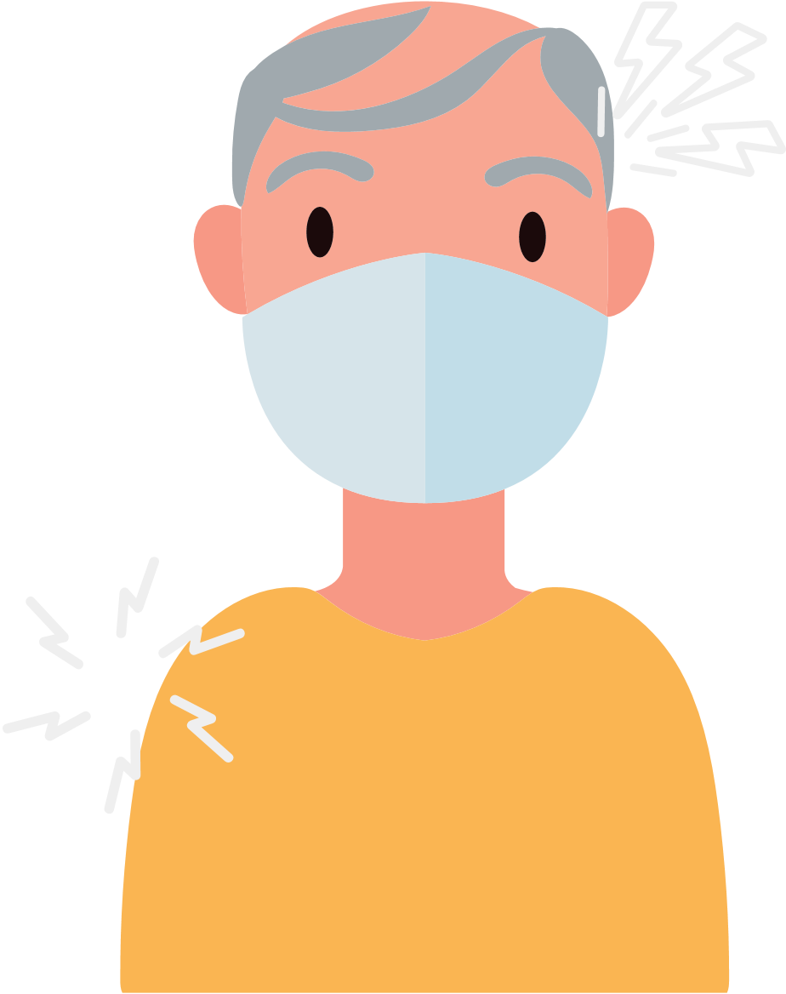
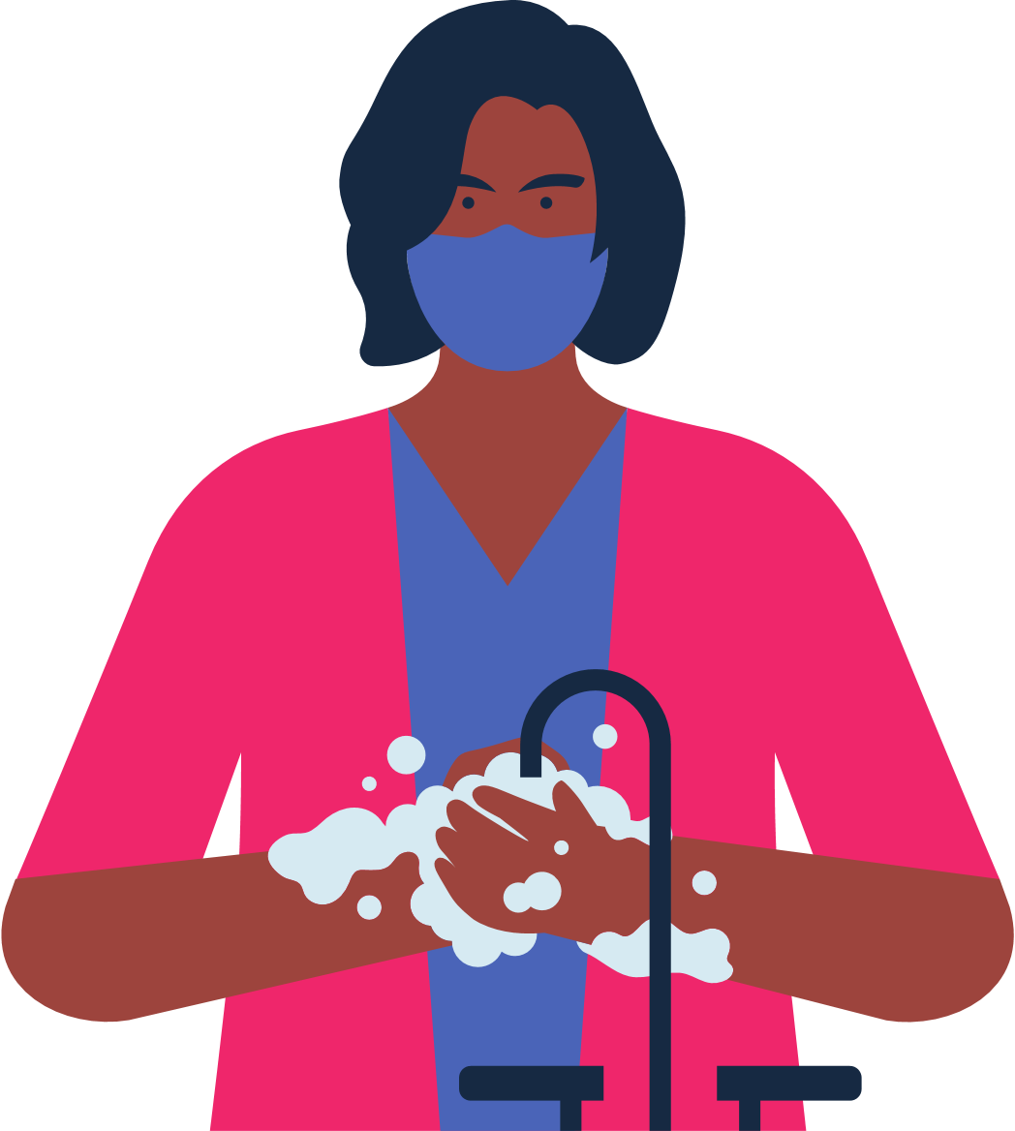
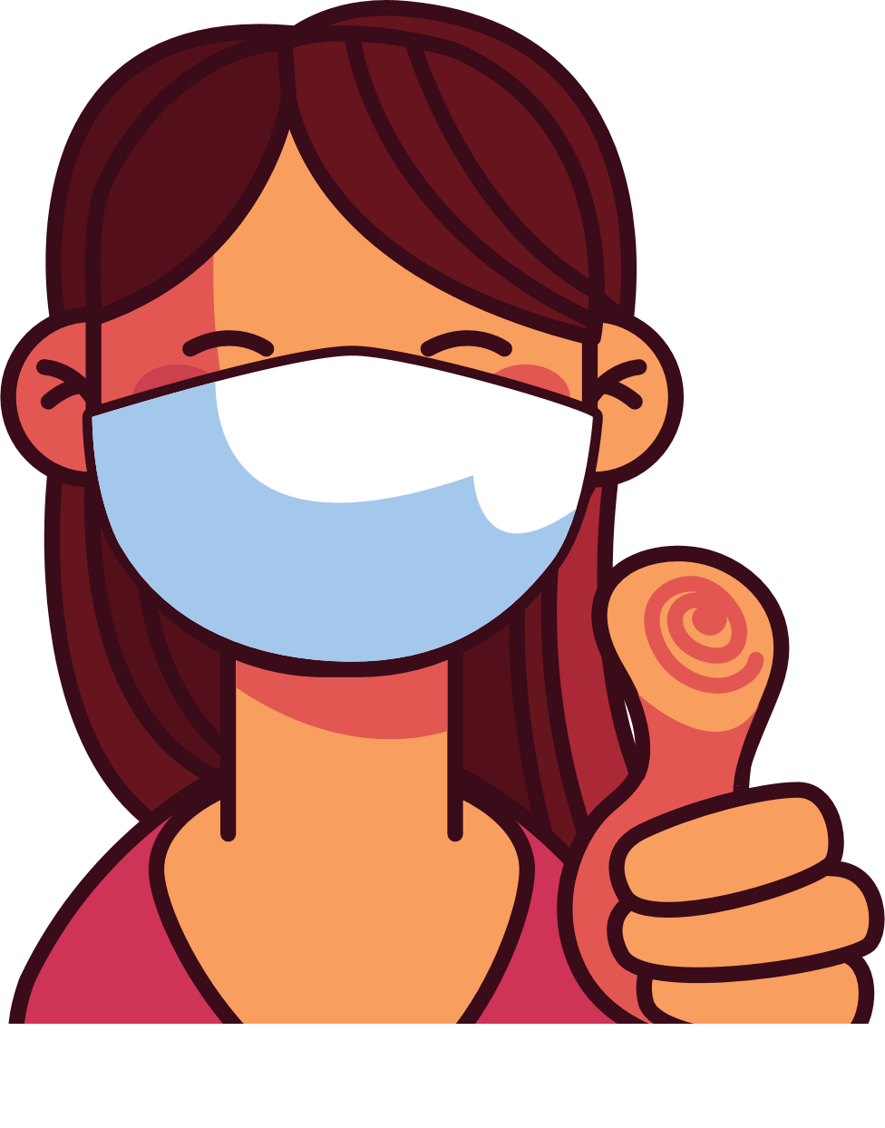
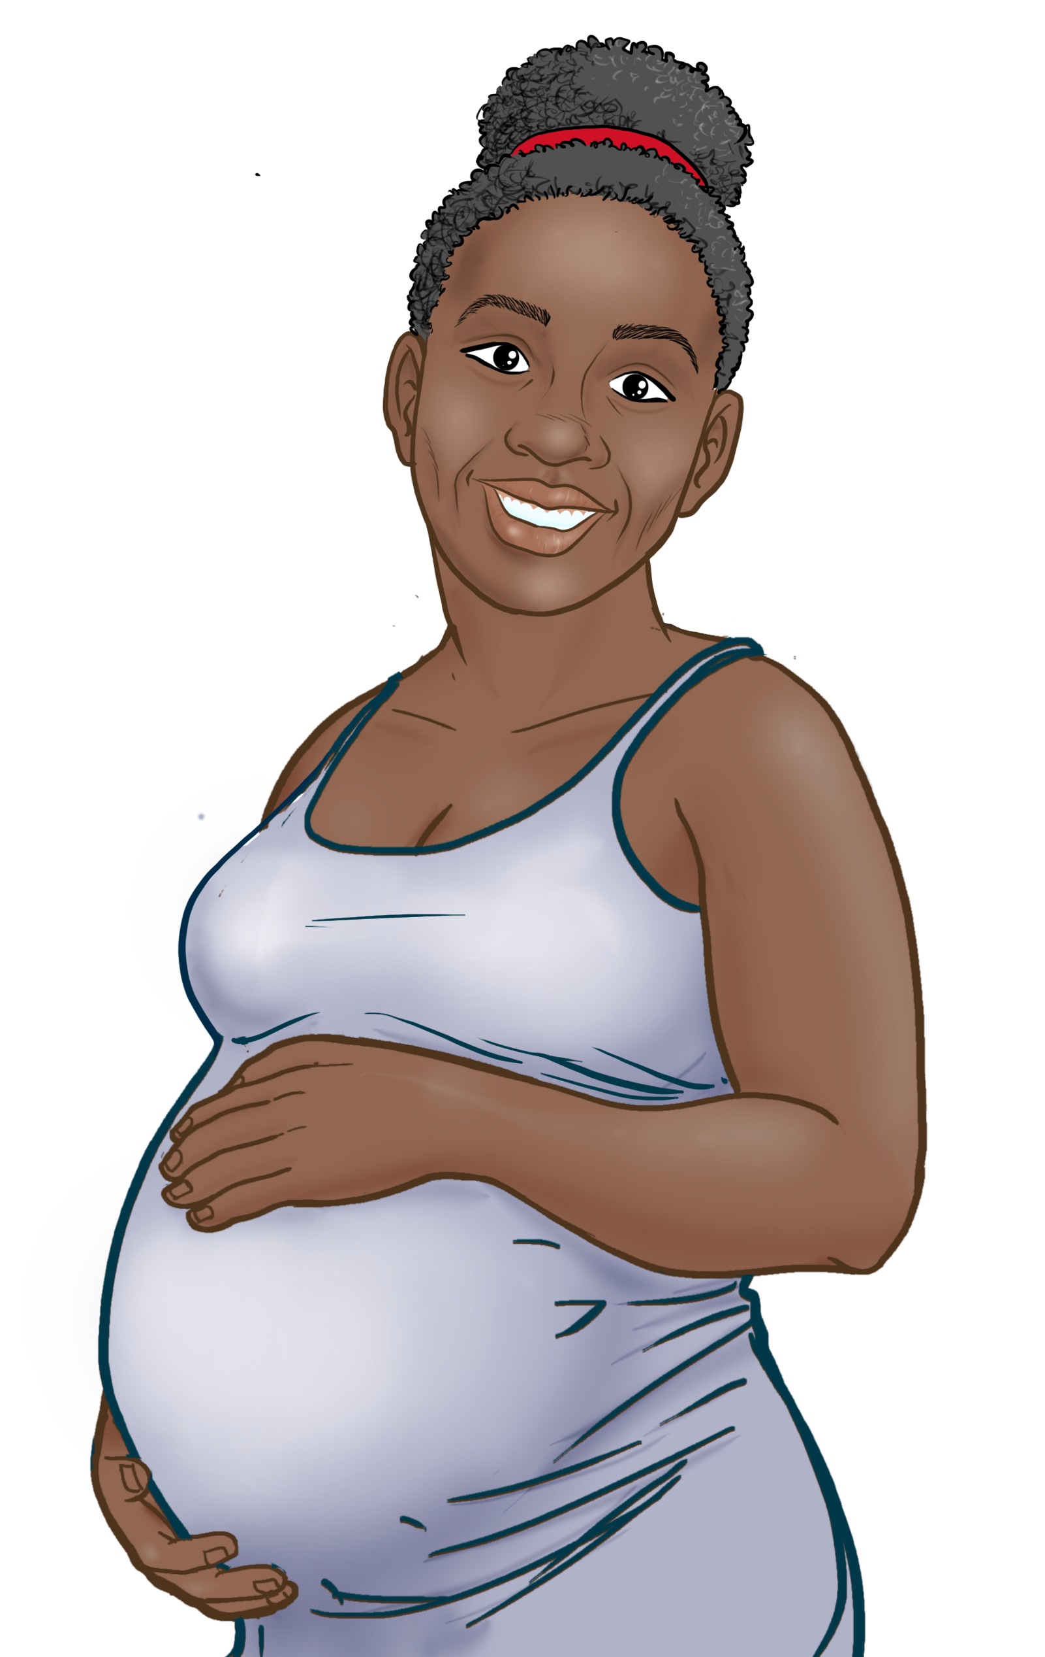
4
COVID-19 VACCINES ARE SAFE AND EFFECTIVE
WHAT TO KNOW WHEN GETTING THE COVID VACCINE
Save the file as a PDF
Once the content of the brochure has been finalized, you can save the file as a PDF for printing and distribution.
Export as a PDF using PPT:
Select slide. File → Save As Adobe PDF
Export as a PDF using Google Slides:
File → Download → PDF Document
Everyone ages six months and older should get a dose(s) of the 2024-2025 COVID-19 vaccine!
People who have stayed up-to-date on their vaccinations get just one shot of a 2024-2025 Pfizer, Moderna, or Novavax COVID-19 vaccine.
BENEFITS OF VACCINATION
Some people get more than one shot: children six months to 5 years, those 12yrs+ who were not up-to-date on vaccines, immunocompromised, and people 65 and older should talk to their doctor.
It is important to get vaccinated, even if you have had COVID-19.
All vaccines against COVID-19 are safe and effective.
Vaccination protects you, your family, your children, and your co-workers from becoming seriously ill and being hospitalized.
Vaccination decreases risks for moms and their babies.
Vaccination decreases the number of new, severe and deadly COVID-19 cases in your community.
Vaccination protects hospitals and healthcare providers from being overwhelmed with patients severely ill with COVID-19.
The more people vaccinated in our community, the less we need to worry about new variants.
Reduces the risk of stillbirth
Antibodies from vaccinated women can pass to their babies and possibly protect babies from COVID-19.
RECOMMENDATIONS
Get your 2024-2025 vaccine(s).
Get your family updated vaccines.
It's not 2020 anymore – but COVID is still making people very sick and we need to take steps to be safe and not spread it!.
If you get sick:
Testing is recommended but not required.
Stay home and away from others until you have been fever-free for 24 hours and you are improving
Then, wear a mask or respirator for 5 days after you have been fever-free for 24 hours
See CDC guidelines for more information.
If you get very sick, go to the doctor!
Check where vaccines are offered for free at your state or local health department, pharmacy, or health center.
After vaccination you may experience: arm pain, headache, fever, or chills.
You will feel better a few days after your injection.
You are considered up to date once you receive your needed dose or doses.
RISKS FOR UNVACCINATED
Higher risk of COVID-19 infection.
Higher risk of serious infection, hospitalization, and death.
Higher risk of being exposed to new mutations that are more contagious and dangerous.
For women of any age who are pregnant, breastfeeding, or trying to get pregnant, vaccines are critical for keeping moms and their babies healthy.
Wash your hands and take steps not to spread COVID-19.
You did your part to protect yourself and others from COVID-19!

